Slide 1
Totalitarianism and Dictators

Slide 2
Questions
In what year did Hitler become the Nazi party leader?
What two things did Hitler use to quash opposition?
What sort of race did Hitler want to establish?
What did Hitler use to spread his beliefs?
In what year did Hitler invade Poland?
List 3 things you notice in the primary source (Hitler).
Who was Benito Mussolini? What was his dream?
What political movement did Mussolini start?
In what year did Mussolini become Prime Minister?
List 3 things you notice in the primary source (Hitler & Mussolini).

Slide 3
Adolf Hitler
Adolf Hitler gained political power by promising to improve the German economy and restore Germany to her former glory.
Hitler was a charismatic leader. He could capture people’s imaginations and persuade people to believe in him. He was also a skillful orator. He could give inspiring speeches that attracted large crowds.
In 1921, Hitler became the leader of the Nazi party. He became the German Chancellor (head of the German government) in 1933. Once in power, Hitler banned all opposition. He used the secret police and the military to quash anyone who opposed him. He referred to his one-party government as the Third Reich. He called himself Führer, which is German for ‘the leader’

Slide 4
Hitler’s Goals
Hitler aimed to establish a perfect, superior race. He believed real Germans descended from the Aryans. The Aryans were people with blonde hair and blue eyes. Hitler wanted to rid Germany of Jewish people because he thought they were inferior. He sent millions of Jewish and other non-Aryan people to concentration camps.
Hitler used propaganda to spread his beliefs. Propaganda is misleading or incorrect information that persuades people to believe what you want them to believe. Hitler used propaganda to promote his ideas about the perfect race and explain why millions of Jews and non-Aryan people should be persecuted.
In 1939 Hitler invaded Poland because he wanted more land for his expanding empire. It was this event that sparked WWII.
Hitler was a dictator – he governed with absolute power

Slide 5
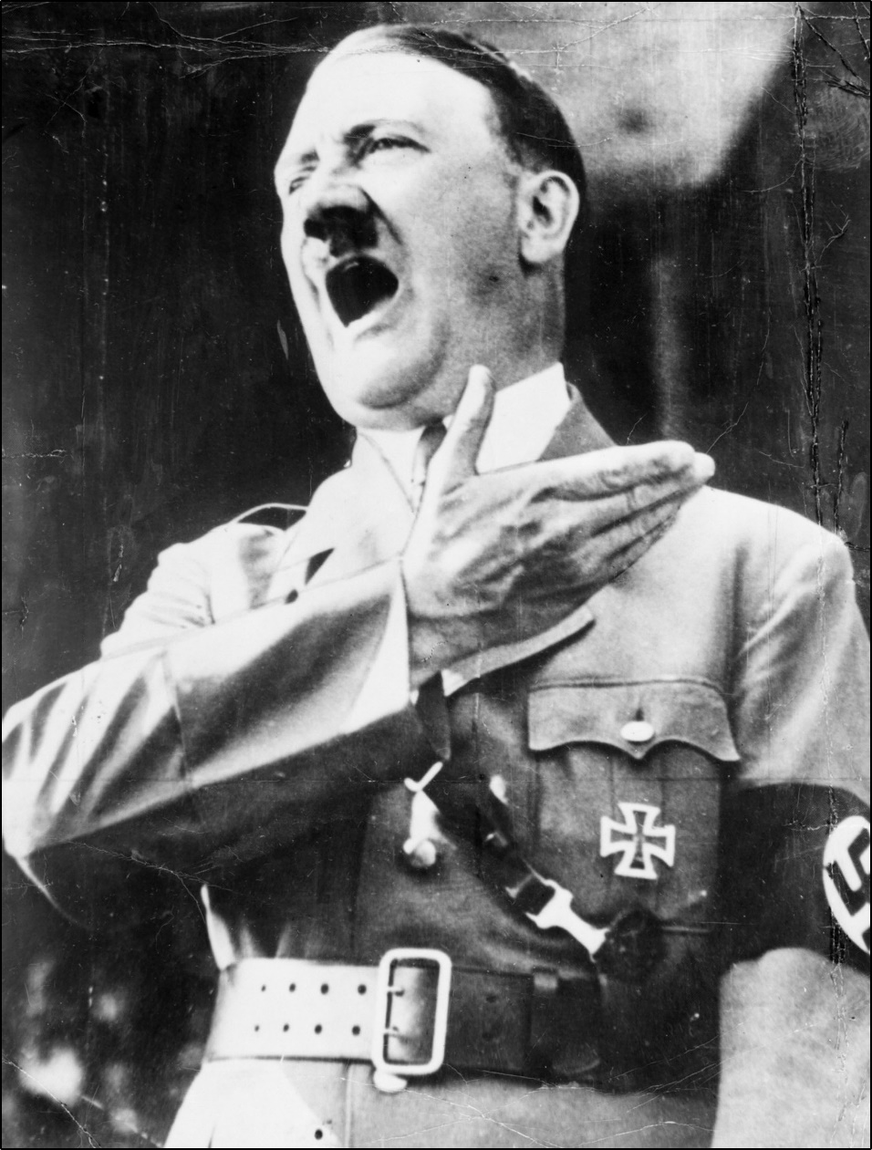
German Chancellor Adolf Hitler
giving a speech, July 1940
Courtesy, Australian War Memorial
P02018.015

Slide 6
Benito Mussolini
Benito Mussolini was an Italian who dreamt of returning Italy to her ancient glory. He began the Italian Fascist Party and was its leader.
In 1922, King Victor Emmanuel of Italy appointed Mussolini as Italian Prime Minister. Mussolini was the youngest man ever to hold this position. Once in power, Mussolini quickly became a dictator.
Why many Italians supported Mussolini
After WWI, Italy was in chaos. Many Italians believed Mussolini could improve Italy’s economy and bring stability to Italy. To help solve the problem of unemployment, Mussolini started rebuilding Italy’s roads and public transport system which provided many jobs. Like Adolf Hitler, Mussolini had a charismatic personality. He was a brilliant public speaker.

Slide 7
Benito Mussolini
The League of Nations was established at the end of WWI. Its aim was to promote international cooperation between nations and keep peace. Mussolini ignored the League’s attempts to resolve Italy’s land claims in Abyssinia. Instead of accepting some Abyssinian land, Italy invaded Abyssinia in 1935. The League imposed trade sanctions on Italy because of this military action. This meant that Italy could not easily import or export goods. However, these trade sanctions were not really enforced and Italy continued its expansion into parts of Africa.

Slide 8
Mussolini outlawed opposition
Mussolini did not tolerate people disagreeing with him or his fascist party. He used secret police and had strong military support. He even had his own military force called the Blackshirts. The Blackshirts murdered and tortured people who opposed Mussolini. Many people lived in fear of Mussolini’s dictatorship. Like Hitler, Mussolini was a ruthless leader.

Slide 9
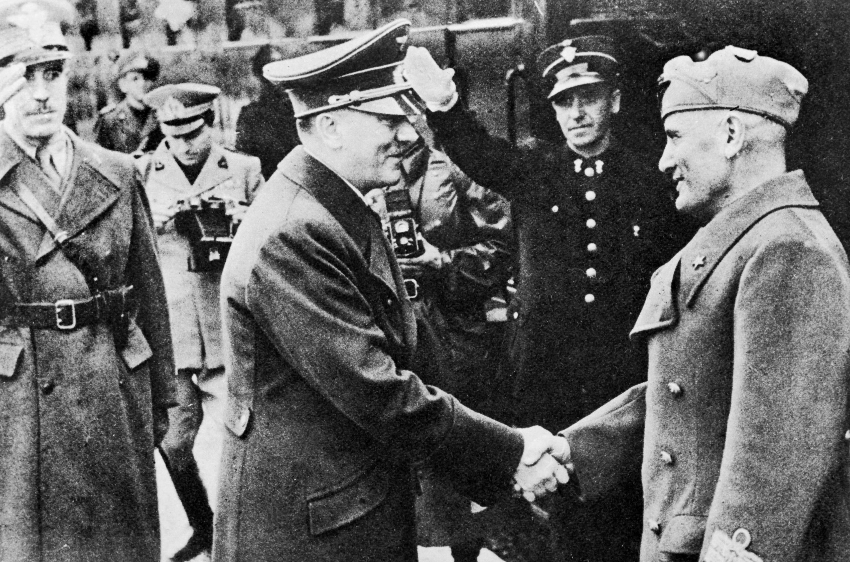
Adolf Hitler (left) and Benito Mussolini (right) after their last meeting, April 1943
Courtesy, Australian War Memorial P02018.203

